Slide 1
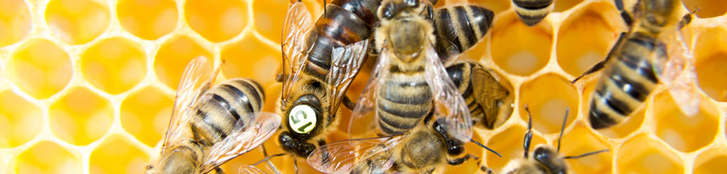
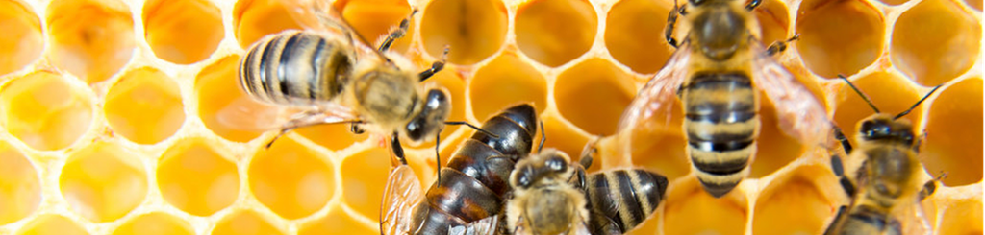
Beehive traffic
G 21
Jonathan Burkhard, Jasmin Fischli, Philipp Göldlin, Julie Veya

Slide 2
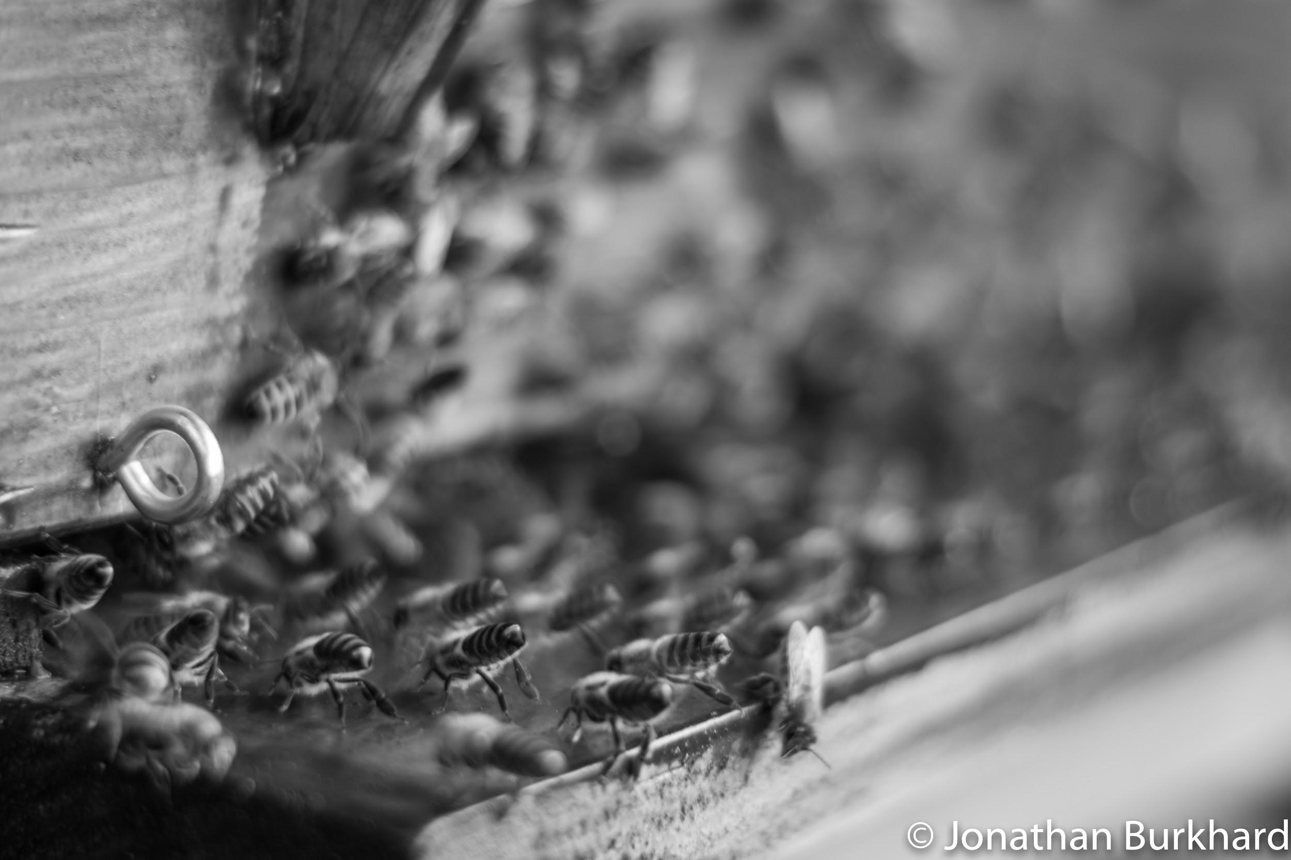
Our Goal
To be able to automatically count the number of bees entering and leaving a hive, using a single camera

Slide 3
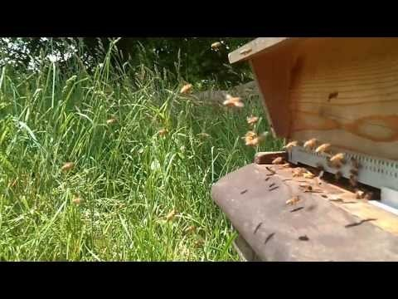
Beehive traffic
https://youtu.be/dydU0QItM84

Slide 4
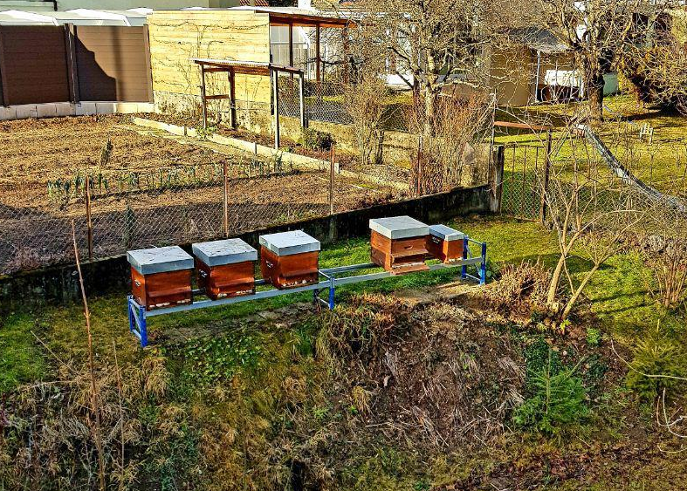
Materials
GoPro Hero 3 camera : wide angle/ aspherical lens, high frame rate
Hives

Slide 5
Method
Background subtraction
Segmentation and ellipse fitting
Tracking of the bees : OpenCV
Determine a logic to count the incoming and outgoing flow of bees : Python
Reconstruct the bees’ paths : COLMAP

Slide 6
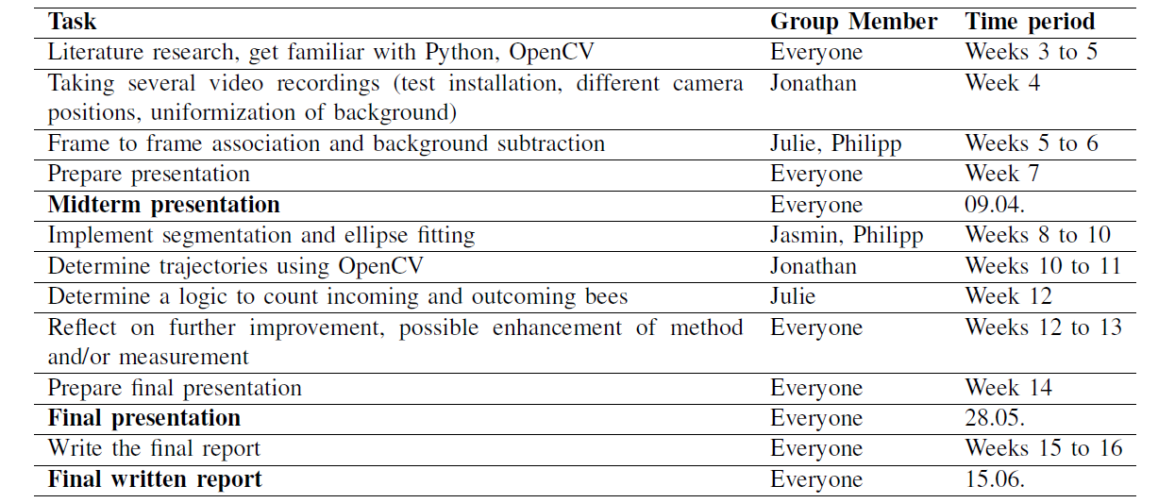
Work packages and timeline

Slide 7
Technical and algoritmic challenges
Bees are extremely fast => High frame rate necessary
Overlapping of bees
Other insects are coming to the party!
High enough resolution for bees moving fast near the camera
Different weather conditions can change drastically the characteristics of the image

Slide 8
Thank you!

